Slide 1
CMS STAR-RATING & PROVIDER ANALYSIS

Slide 2
OBJECTIVE
CMS contracted to work in collaboration with other contractors to develop a methodology for the Overall Hospital Quality Star Ratings on Hospital Compare. Hospital Compare includes information on more than 100 quality measures and more than 4,000 hospitals. The primary objective of the Overall Hospital Quality Star Ratings project is to develop a statistically sound methodology for summarizing information from the existing measures on Hospital Compare in a way that is useful and easy to interpret for patients and consumers. Consistent with other CMS Star Rating programs, this methodology assigns each hospital between one and five stars, reflecting the hospital’s overall performance on selected quality measures.
Our objective is to focus on developing an approach to calculate hospital ratings and using it to identify areas of improvement for certain hospitals which also requires a thorough understanding of the rating system developed by CMS and provide recommendations for hospital to improve star ratings

Slide 3
STAGES
Data Understanding
Which involves understanding and identifying of groups and measures
Data Preparation
Involves cleaning of data(Removing duplicates ,Removing unrequited variables ,Treating missing data and null values checking for outliers .Removing crude data.
Involves processing of data and analysing .Identify important measures affecting star ratings
Data Modelling
Using best models that adhere the problem statement and analyze the best supervised and unsupervised models
Provider Analytics
Using the best methodologies to improve star ratings

Slide 4
DATA UNDERSTANDING
CMS included 64 measures (or variables) classified under 7 groups having a certain weightage as follows:
Groups
• Mortality, Readmission, Safety of Care, Patient Experience (22% weightage groups)
• Timeliness of care, Effectiveness of care, Medical Imaging Efficiency (4% weightage groups).
Measures :
Star Ratings are intended for acute care hospitals, CMS first omitted all measures on Hospital Compare that were specific to specialty hospitals (such as a cancer hospital or inpatient psychiatric facility), or ambulatory surgical centers prior to applying any measure selection criteria. With these measures omitted, the total number of measures eligible for inclusion in the Star Rating for October 2016 is 115 measures.

Slide 5
DATA UNDERSTANDING
Measure Selection Criteria
CMS uses the following criteria to exclude measures from the Star Rating calculation:
Measures suspended, retired, or delayed from public reporting on Hospital Compare;
Measures with no more than 100 hospitals reporting performance publicly;
Structural measures;
Measures for which it is unclear whether a higher or lower score is better (non-directional);
Measures no longer required for Inpatient Quality Reporting (IQR) Program or Outpatient Quality Reporting (OQR) Program; and
Duplicative measures (e.g., individual measures that make up a composite measure that is also reported; or measures that are identical to another measure).
• Positive measures:
Patients given appropriate vaccines, Patients given timely treatment etc.
• Negative measures:
All mortality measures, readmission measures.(ex:time taken for emergency care)

Slide 6
DATA UNDERSTANDING – DATA HANDLING
Data Formatting:
The original data is in ‘wide-format’ which was converted into one ‘long’master file such that each row represents a provider and each column a measure
Each cell is a numeric score of a measure
Standardization of Measure Scores :
For all selected measures, CMS transforms the measures into a single, common scale to account for differences in measure score format, differences in score direction, and the occurrence of extreme outliers. A measure is standardized by subtracting the national mean of measure scores from a hospital’s measure score and dividing it by the standard deviation across hospitals. Measure direction is standardized by reversing the direction of the standardized scores for all measures for which “lower score is better,” and converting them into “higher score is better” measures. Finally, CMS utilizes Winsorization to limit the influence of measures with extreme outlier values at the 0.125th percentile (Z=-3) and the 99.875th percentile (Z=3).
Winsorization is a common strategy used to set extreme outliers to a specified percentile of the data. All standardized measure scores above 3 are set to be 3, and all standardized below -3 are set to be -3. Higher score is better performance.
Missing Values :
More than 50% of missing data have been imputed as per the guidelines provided by the CMS
Duplicates and Outliers are handled.

Slide 7
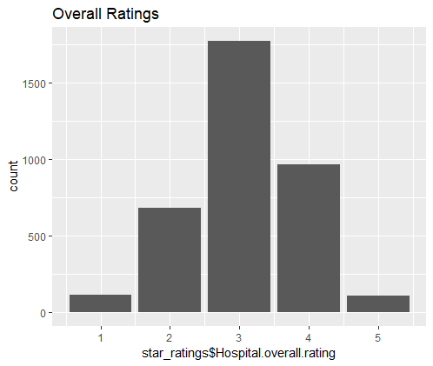
OVERALL RATINGS
RATINGS | NO_OF_PROVIDERS
1 | 117 (3.4%)
2 | 659 (19.5%)
3 | 1426 (42.2%)
4 | 749 (22.1%)
5 | 110 (3.3%)
Approx 42% providers have 3 star rating
Approx 20% providers have 2 and 4 star rating
Approx 3.4% providers have 1 and 5 star rating

Slide 8
Overview of Methodology
The methodology takes a five-step approach to calculating the Star Ratings
. The measures are first selected based on their relevance and importance as determined through stakeholder and expert feedback, and the included measures are standardized to be consistent in terms of direction and magnitude.
These standardized measures are then organized into seven groups according to measure type.
Third, for each group a latent variable model/Factor Analysis is used to estimate a group score for each hospital reporting measures in that group.
In the fourth step, a weight is applied to each group score, and all available groups are averaged to calculate the hospital summary score.
Finally, to assign a Star Rating, the hospital summary scores are organized into five ordered categories using a clustering algorithm.
In addition to the Star Ratings, CMS also organized hospitals into one of three group performance categories (above, same as, and below the national average) for each of the hospital’s available groups, providing additional detail for patients and consumers.

Slide 9
Weightage of Groups
Group | Star Ratings Weight
Mortality | 22%
Safety of Care | 22%
Readmission | 22%
Patient Experience | 22%
Effectiveness | 4%
Timeliness | 4%
Effecient use of Medical Imaging | 4%
CMS reports hospital performance at the group level, separately categorizing each of a hospital’s available group scores into one of three group performance categories (above, same as, and below the national average )

Slide 10
Group performance Category
In addition to a hospital’s Star Rating, CMS reports a group performance category for each of a hospital’s available (i.e., meeting the minimum threshold) measure groups. To calculate a performance category, a hospital’s group score is compared to the national average group score. The LVM for each group produces a point estimate and standard error that can be used to construct a 95% confidence interval for each hospital’s group score for comparison to the national mean group score. The group performance categories are:
“Above the national average,” defined as a group score with a confidence interval that falls entirely above the national average;
“Same as the national average,” defined as a group score with a confidence interval that includes the national average; and
“Below the national average,” defined as a group score with a confidence interval that falls entirely below the national average.

Slide 11
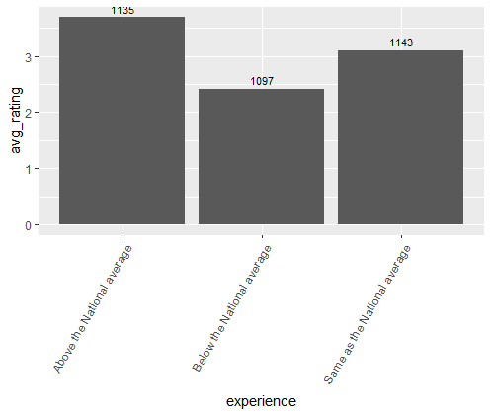
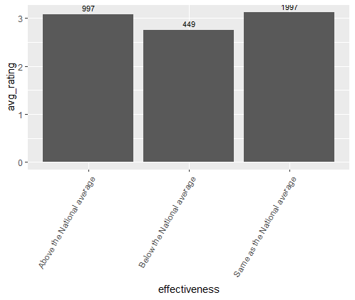
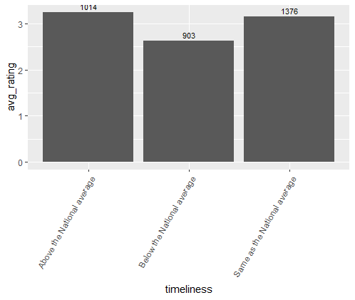
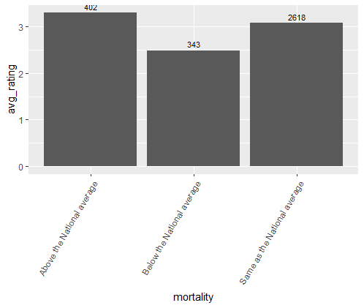
DISTRIBUTION OF AVG RATINGS ON GROUPS

Slide 12

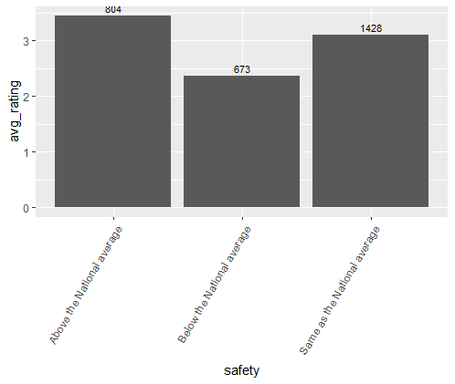
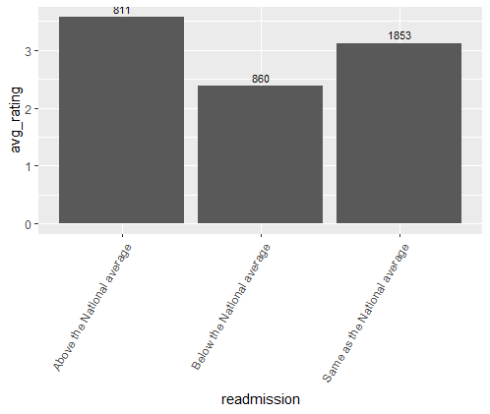
DISTRIBUTION OF AVG RATINGS ON GROUPS

Slide 14
Measure Importance

